Slide 1
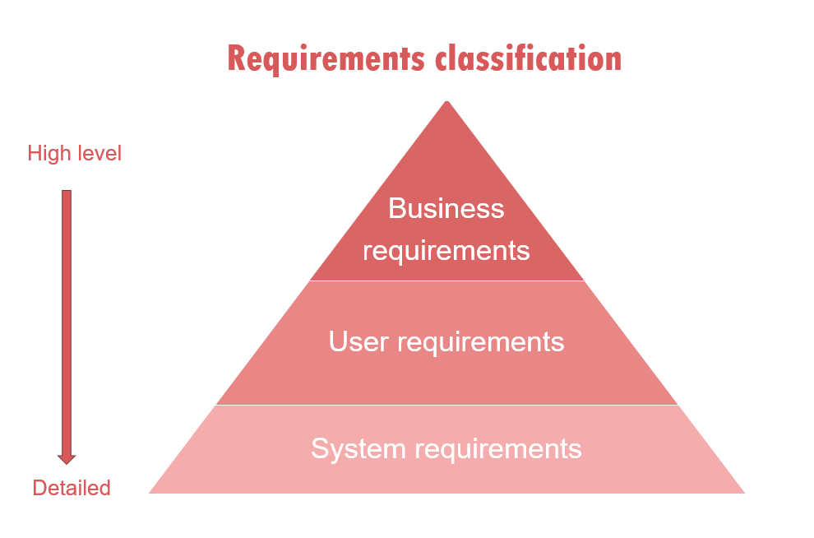
Week-4-Lesson-1 Understanding Requirements, Use Case and Use case Description

Slide 2
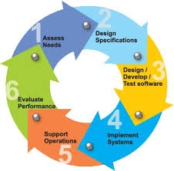
Topics Covered
Requirements Engineering
Requirements analysis
Elements of Requirements Engineering
Classification of Requirements
Functional Requirements
Non-Functional Requirements
Use Case Diagram
Use Case Description

Slide 3
Requirements Engineering
Requirements Engineering
Requirements are statements of what the system must do, how it must behave, the properties it must exhibit, the qualities it must possess, and the constraints that the system and its development must satisfy.
Requirements analysis
specifies software’s operational characteristics
indicates software's interface with other system elements
establishes constraints that software must meet

Slide 4
Requirements Engineering
1. Inception—ask a set of questions that establish …
basic understanding of the problem
the people who want a solution
the nature of the solution that is desired, and
the effectiveness of preliminary communication and collaboration between the customer and the developer
2. Elicitation—elicit/produce requirements from all stakeholders
3. Elaboration—create an analysis model that identifies data, function and behavioral requirements
4. Negotiation—agree on a deliverable system that is realistic for developers and customers

Slide 5
Requirements Engineering
5. Specification—can be any one (or more) of the following:
A written document
A set of models
A formal mathematical
A collection of user scenarios (use-cases)
A prototype
6. Validation—a review mechanism that looks for
errors in content or interpretation
areas where clarification may be required
missing information
inconsistencies (a major problem when large products or systems are engineered)
conflicting or unrealistic (unachievable) requirements.
7. Requirements management

Slide 6
Classification of Requirements

Slide 7
Classification of requirements
Business requirements. These include high-level statements of goals, objectives, and needs.
Stakeholder requirements. The needs of discrete stakeholder groups are also specified to define what they expect from a particular solution.
Solution requirements. Solution requirements describe the characteristics that a product must have to meet the needs of the stakeholders and the business itself.
Nonfunctional requirements describe the general characteristics of a system. They are also known as quality attributes.
Functional requirements describe how a product must behave, what its features and functions.
Transition requirements. An additional group of requirements defines what is needed from an organization to successfully move from its current state to its desired state with the new product.

Slide 8
Functional Requirements
Functional requirements describe system behavior under specific conditions and include the product features and functions which web & app developers must add to the solution. Such requirements should be precise both for the development team and stakeholders.
The list of examples of functional requirements includes:
Business Rules
Transaction corrections, adjustments, and cancellations
Administrative functions
Authentication
Authorization levels
Audit Tracking
External Interfaces
Certification Requirements
Reporting Requirements
Historical Data

Slide 9
Example of Functional Requirements
Here, are some examples of non-functional requirement:
The software automatically validates customers against the ABC Contact Management System
The Sales system should allow users to record customers sales
The background color for all windows in the application will be blue and have a hexadecimal RGB color value of 0x0000FF.
Only Managerial level employees have the right to view revenue data.
The software system should be integrated with banking API

Slide 10
Non-Functional Requirements
A non-functional requirement defines the quality attribute of a software system. They represent a set of standards used to judge the specific operation of a system. Example, how fast does the website load?
Some typical non-functional requirements are:
Performance – for example Response Time, Throughput, Utilization, Static Volumetric
Capacity
Availability
Reliability
Recoverability
Maintainability
Serviceability
Security
Regulatory
Manageability
Environmental
Data Integrity
Usability

Slide 11
Example of Non-Functional Requirements
Here, are some examples of non-functional requirement:
Users must change the initially assigned login password immediately after the first successful login. Moreover, the initial should never be reused.
Employees never allowed to update their salary information. Such attempt should be reported to the security administrator.
Every unsuccessful attempt by a user to access an item of data shall be recorded on an audit trail.
A website should be capable enough to handle 20 million users with affecting its performance
The software should be portable. So moving from one OS to other OS does not create any problem.
Privacy of information, the export of restricted technologies, intellectual property rights, etc. should be audited.

Slide 12
Elements of the analysis model
Elements of the analysis model
Scenario-based elements
Functional—processing narratives for software functions
Use-case—descriptions of the interaction between an “actor” and the system
Class-based elements
Implied by scenarios
Behavioral elements
State diagram
Flow-oriented elements
Data flow diagram

Slide 13
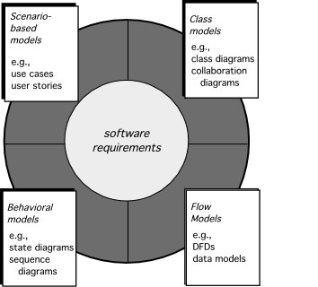
Elements of Requirements Analysis

Slide 14
Use-Cases
Use cases describe the interaction between the system and external users that leads to achieving particular goals.
Each use case includes three main elements:
Actors. These are the users outside the system that interact with the system.
System. The system is described by functional requirements that define an intended behavior of the product.
Goals. The purposes of the interaction between the users and the system are outlined as goals.
There are two formats to represent use cases:
Use case specification/description
Use case diagram

Slide 15
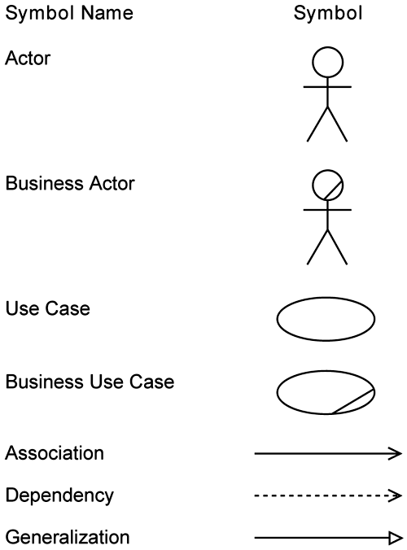
Use-Cases Elements

Slide 16
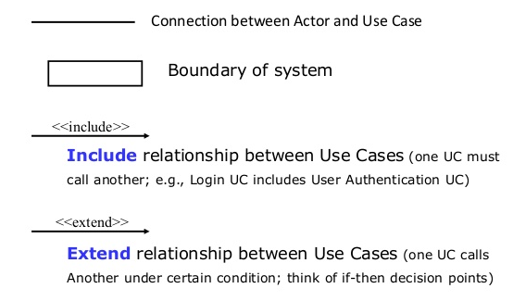
Use-Cases Elements

Slide 17
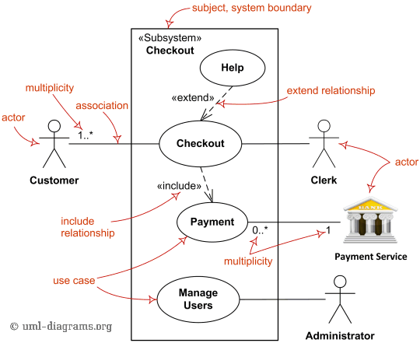
Use Cases Elements

Slide 18
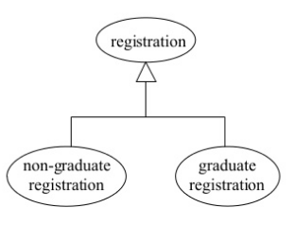
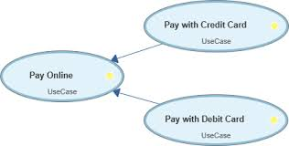
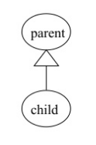
Use-Cases Generalization
The child use case inherits the behavior meaning of the parent use case
The Child may add to or override the behavior of its parent.

Slide 19
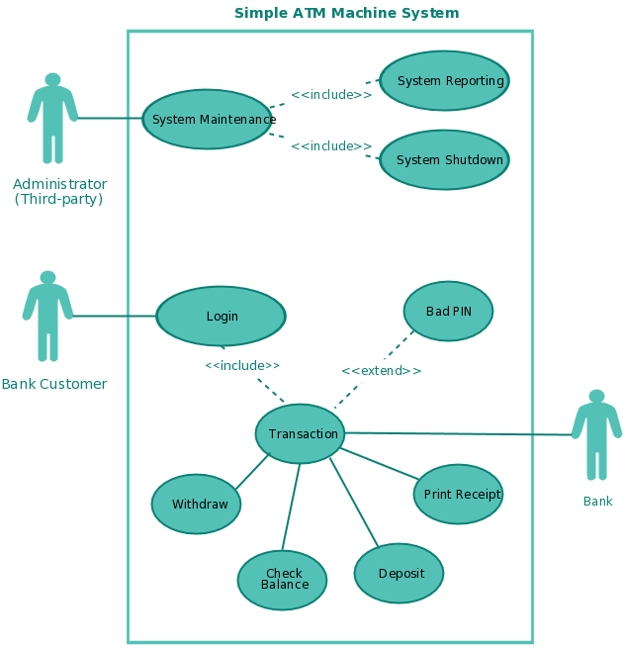
Use-Cases Diagram

Slide 20
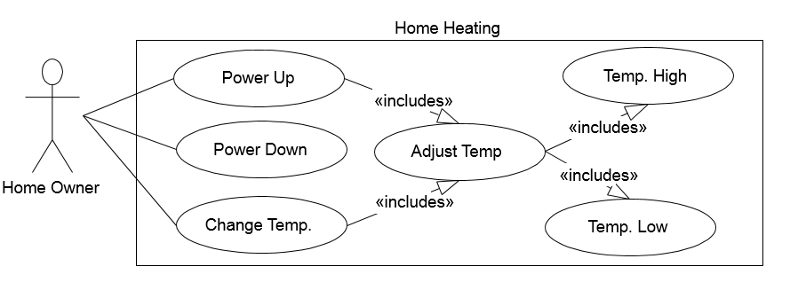
Home Heating System

Slide 21
Home Heating System
Use Case Description
Use case: Power Up
Actors: Home Owner (initiator)
Type: Primary and essential
Description: The Home Owner turns the power on.
Perform Adjust Temp. If the temperature in all rooms is
above the desired temperature, no actions are taken.

Slide 22
Home Heating System
Use case: Adjust Temp
Actors: System (initiator)
Type: Secondary and essential
Description: Check the temperature in each room. For each room:
Below target: Perform Temp Low
Above target: Perform Temp High

Slide 23
Home Heating System
Use case: Temp Low
Actors: System (initiator)
Type: Secondary and essential
Description: Open room valve, start pump if not started.
If water temp falls below threshold,
open fuel value and ignite burner.

Slide 24
Use Case Scenario
Home Assignment distribution and Collection System(HACS)
Homework assignment and collection are an integral part of any educational system. Today, this task is performed manually. What we want the homework assignment distribution and collection system to do is to automate this process.
The system will be used by the Instructor/Teacher to distribute the homework assignments, review the students’ solutions, distribute suggested solution, and distribute student grades on each assignment.
This system will also help the students by automatically distributing the assignments to the students, provide a facility where the students can submit their solutions, remind the students when an assignment is almost due, remind the students when an assignment is overdue.

Slide 25
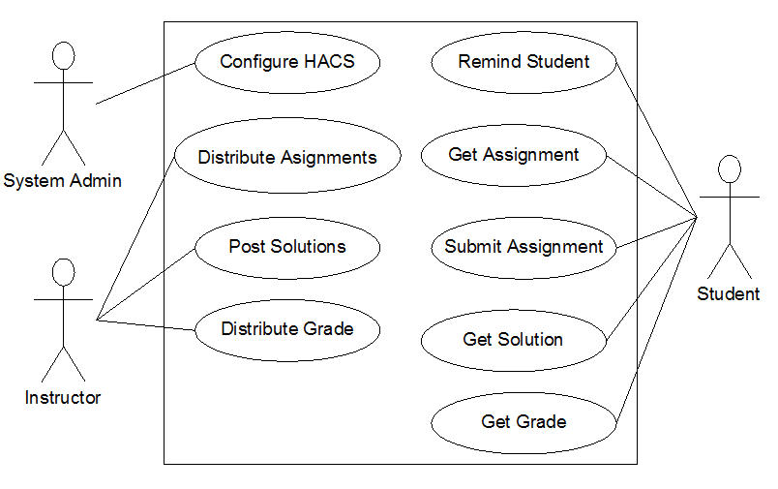
Home Assignment distribution and Collection System
Use Case Diagram

Slide 26
HACS Use Cases Description
Use case: Distribute Assignments
Actors: Instructor (initiator)
Type: Primary and essential
Description: The Instructor completes an assignment and submits it to the system. The instructor will also submit the
due date and the class the assignment is assigned for.

Slide 27
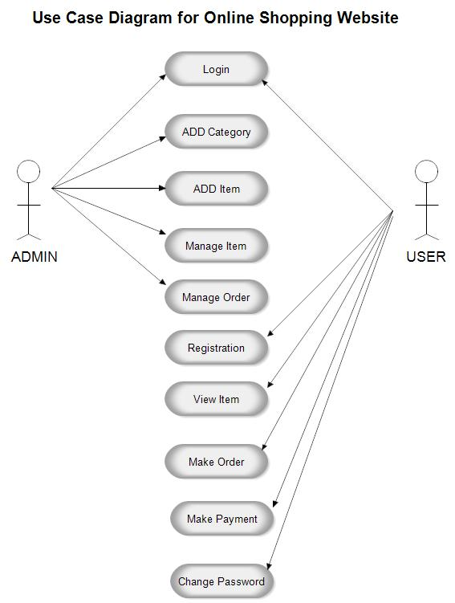

Slide 28
Example: Use Case Scenario
A user can request a quiz for the system. The system picks a set of questions from its database, and compose them together to make a quiz. It rates the user’s answers, and gives hints if the user requests it.
In addition to users, we also have tutors who provide questions and hints. And also examinations who must certify questions to make sure they are not too trivial, and that they are sensual.
Make a use case diagram to model this system. Work out some of your use cases. Since we don’t have real stake holders here, you are free to fill in details you think is sensual for this example.

Slide 29
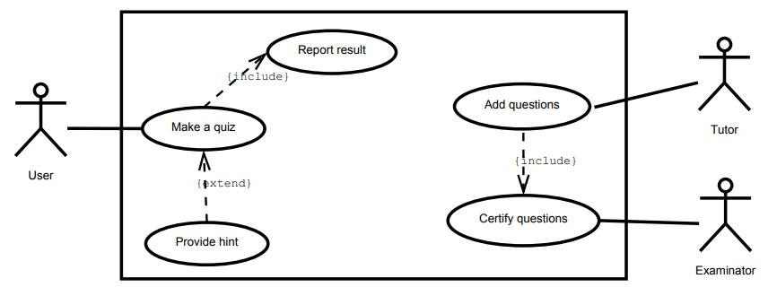
Use Case Diagram

Slide 30
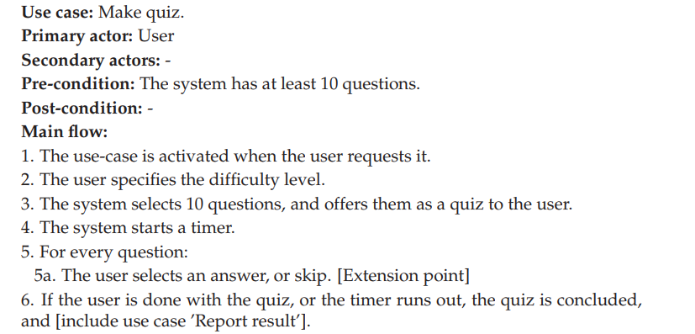
Use Case Description

Slide 31
References:
Software Engineering A practitioner’s Approach by Roger S. Pressman, 7th edition, McGraw Hill, 2010.
Software Engineering by Ian Sommerville, 9th edition, Addison-Wesley, 2011
FUNCTIONAL VS NON-FUNCTIONAL REQUIREMENTS: MAIN DIFFERENCES & EXAMPLES
https://theappsolutions.com/blog/development/functional-vs-non-functional-requirements/

